Slide 1
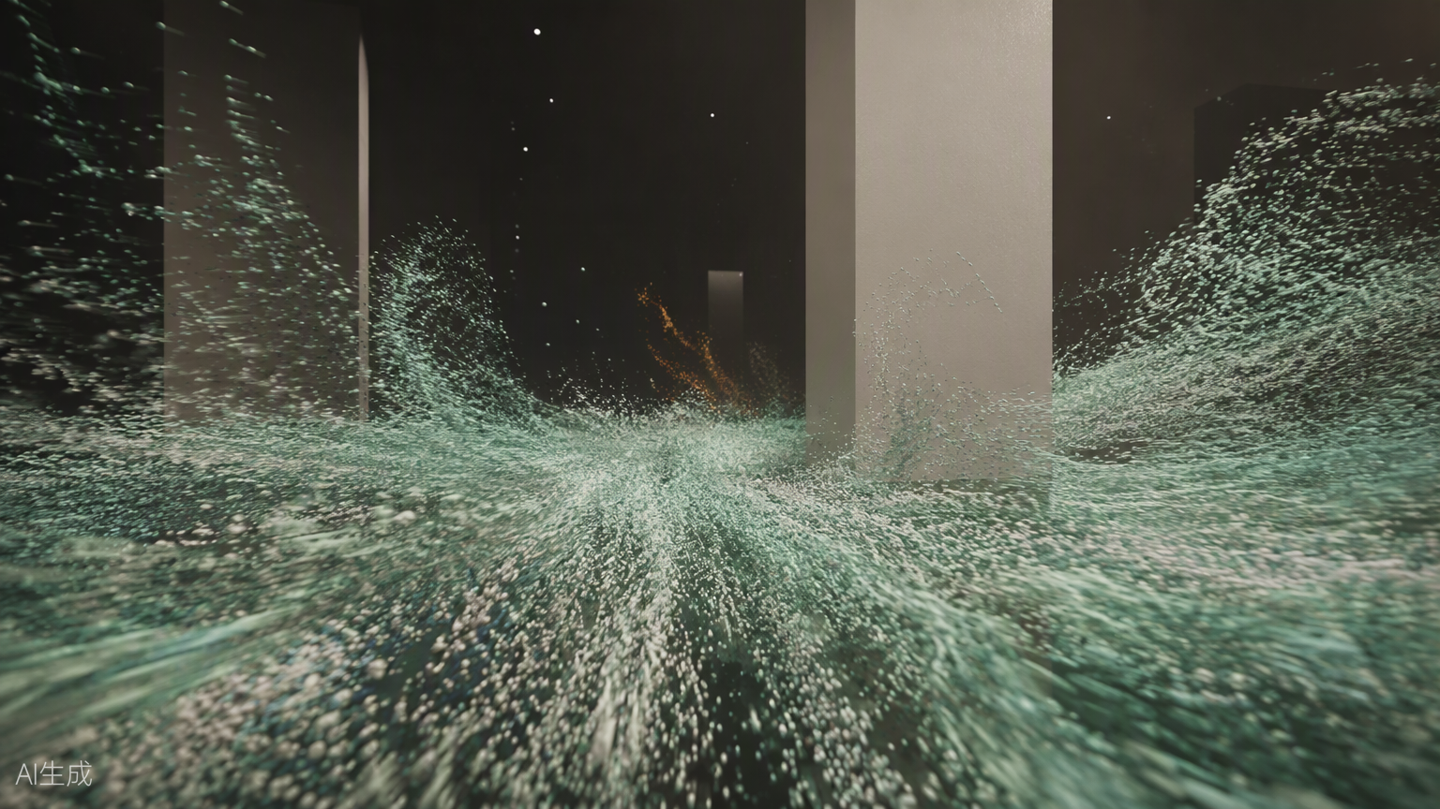
RESEARCH PORTFOLIO / INTERACTIVE CONCEPT
DATA-VIZ PILOT · 2026
PUBLIC POOL
INTERACTIVE RESEARCH DEMO
Particle Replay of Body–Space Trajectories
and Unnoticed Self-Discipline
When the pool replays only the majority route,
does it represent a collective—or produce a way of viewing?
Concept demo: real body data · simulated spatial routes · simulated public pool

Slide 2
01 / RESEARCH PREMISE
When personal body–space traces enter a majority-shaped pool, how do we understand ourselves in relation to the collective?
01
Research Premise
and Core Concept
Research Focus
Public Pool
How participants describe self, collective and deviation after viewing the two replay modes.
The most frequently travelled routes and principal dwell points form a visible collective norm.
Defining “Unconscious”
PhD application portfolio
Desktop interactive concept demo
Unnoticed behavioral adjustment and self-discipline—not covert collection. Consent authorizes participation; the study examines responses after viewing.
02

Slide 3
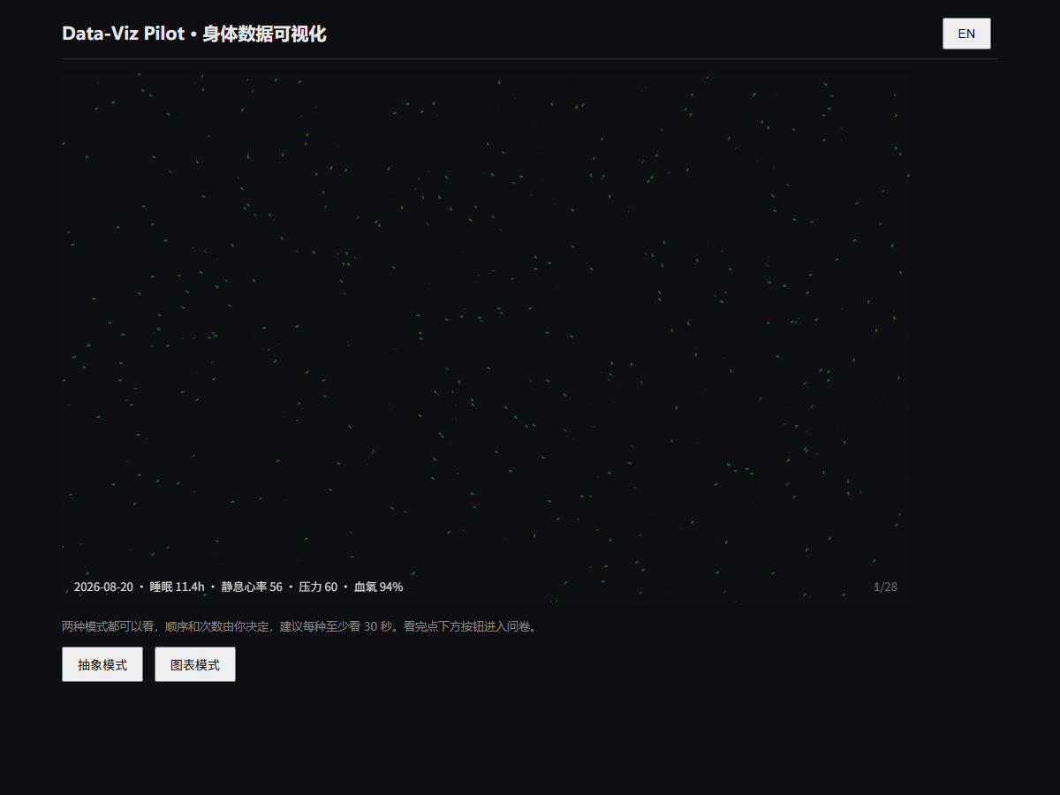
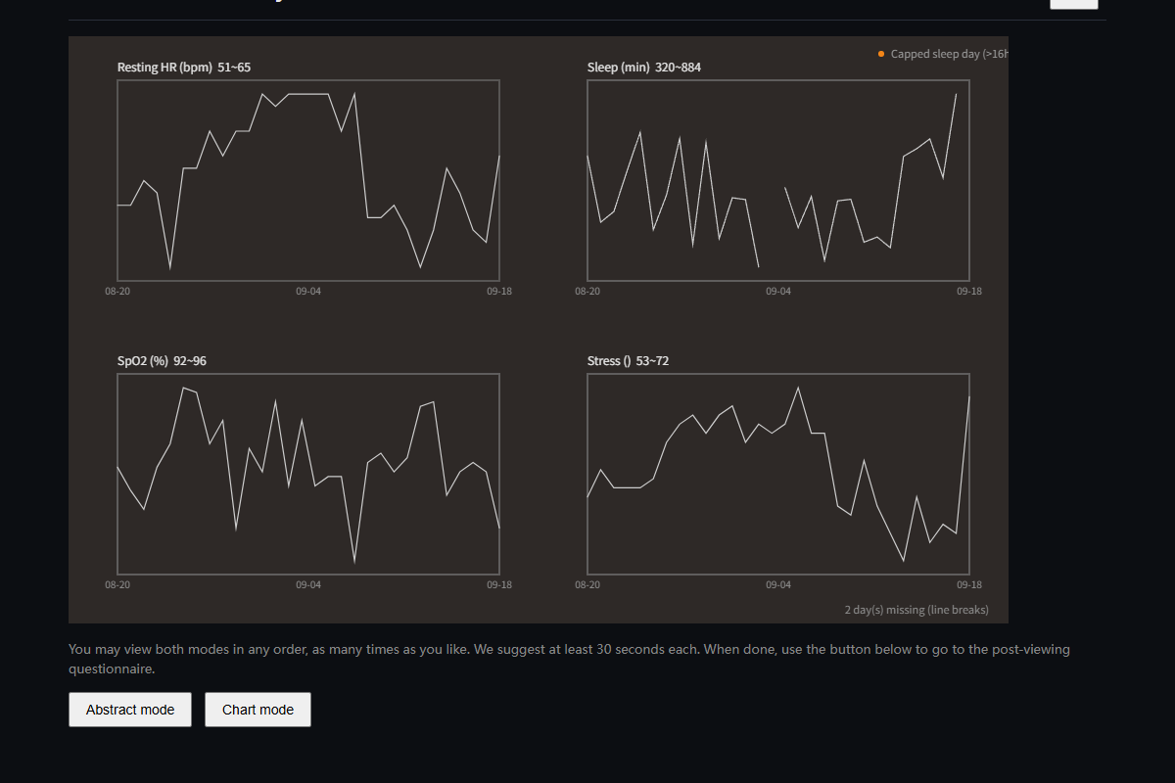
02 / EXISTING PROTOTYPE
Implemented · v0.5
A Working Pilot as the Research Foundation
Conventional charts for four measures
01 Dual-view modes and switching logs
02 Pool simulation and “without me”
03 Consent, pre/post tests and export
Abstract particle visualization driven by personal real-world data
03

Slide 4
03 / FEEDBACK LOOP
From Data Contribution to Collective Feedback
The study examines how individuals enter a collective and how they interpret their next actions after seeing its norms.
Body Record
Abstraction
Aggregation
Personal Review
Reflection
Physiological data
Routes and dwell
Particle body
Spatial replay
Majority routes
Dwell hotspots
Alignment and deviation
“Without me”
Questionnaires
Return intentions
Research boundary | Feedback and self-adjustment remain hypotheses. This application presents responses and imagined adjustments, not evidence of actual discipline.
04

Slide 5
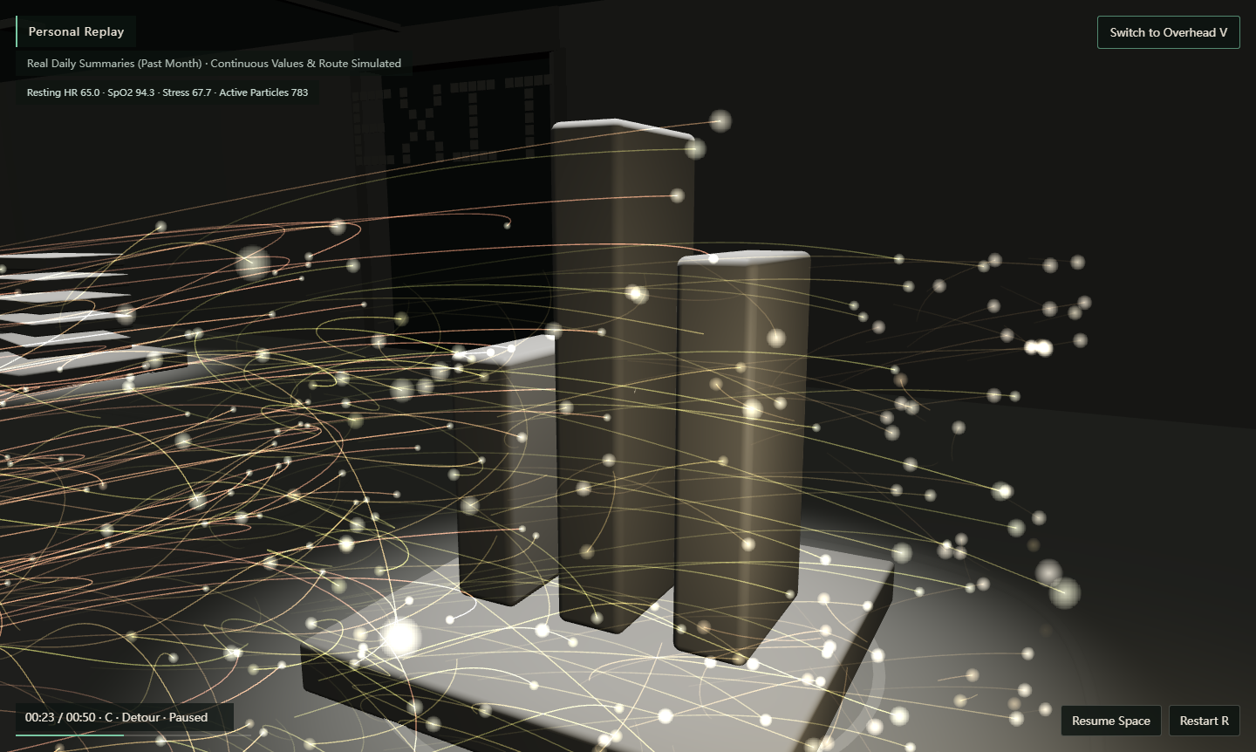
IMPLEMENTED VIEW 01
Personal Replay
A single-point core emits particles that reconstruct movement, dwell and departure.
Route Movement and turning
Dwell Gathering, orbiting, slowing
Body Speed, density, hue, trails
Camera Low follow or overhead
Actual demo screenshot. Real daily summaries; continuous values and spatial routes are simulated.
05

Slide 6
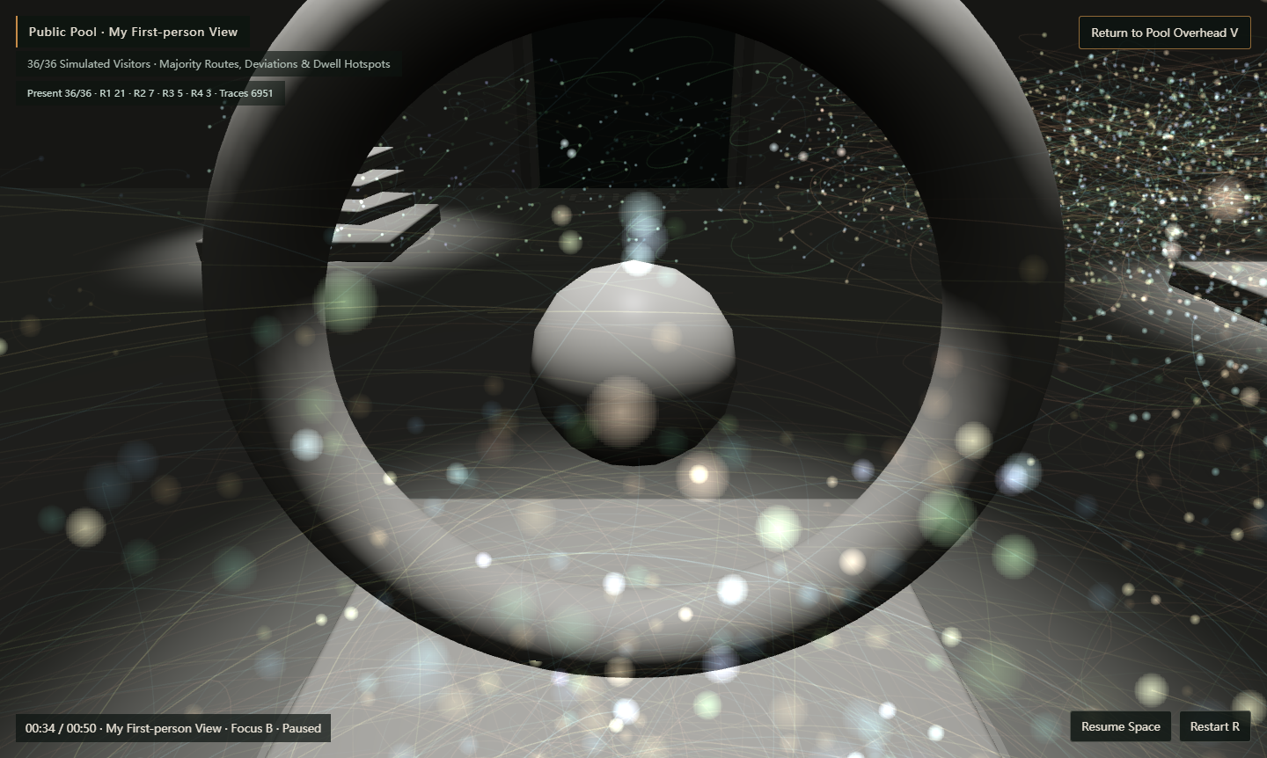
IMPLEMENTED VIEW 02
Public Pool
“I” gradually lose
an independent route
and rhythm.
01 The collective enters view
02 Majority routes set a rhythm
03 Individual traces are absorbed
Actual first-person demo screenshot with 36 simulated visitors across four route variants.
06

Slide 7
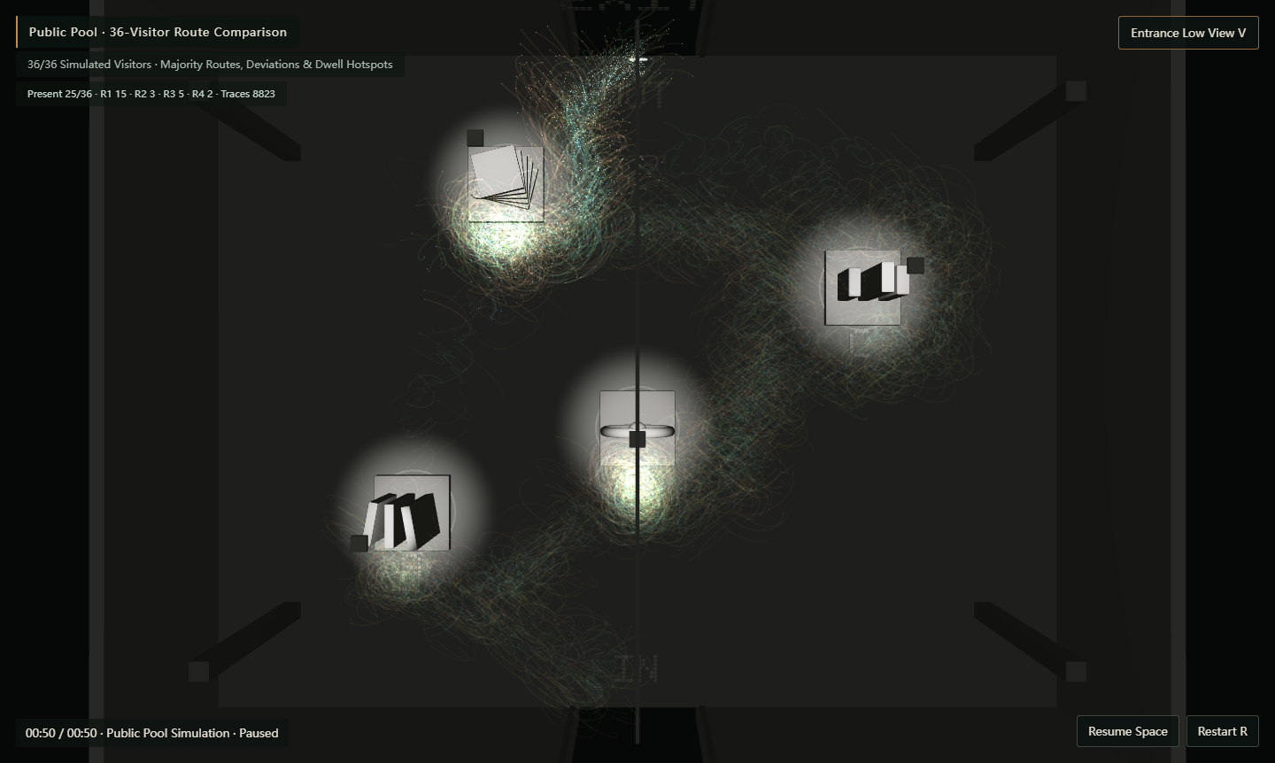
IMPLEMENTED VIEW 03
Seeing the Rules
Majority routes, dwell hotspots and minority deviations
Majority Routes
Dwell Hotspots
Minority Deviations
Particle density reveals repeatedly chosen paths and collective direction.
Clusters mark where the greatest number of visitors linger.
Four route variants keep less common choices visible within the collective field.
07

Slide 8
04 / EXPERIENCE STRUCTURE
One Continuous Gallery, Five Narrative States
The gallery remains continuous while particles, camera and information layers change.
01 Enter
02 Personal Replay
03 Public Pool
04 Self & Collective
05 Research Frame
15—20 sec
Distant gaze
Research question
60—90 sec
Low follow
Routes and dwell
60—75 sec
Collective immersion
Overhead withdrawal
45—60 sec
Overlap and deviation
“Without me”
Free reading
Current evidence
Future research
Advisor presentation | Approximately 4 minutes, or 2 minutes without personal node exploration. Automated camera flow supports continuity; manual controls support discussion.
08

Slide 9
05 / CAMERA STORYBOARD
Public Pool Camera: Enter, Then Step Back
00—08s Personal epilogue Hold the low camera as other particles enter.
08—22s Collective immersion “I” leave the visual center as the collective occupies the space.
22—42s Majority rhythm Follow majority routes and gather at principal dwell points.
42—55s Finding deviation Briefly highlight personal traces to compare alignment and deviation.
55—75s Overhead withdrawal “I” dissolve; the pool continues as the camera rises.
60–75s
Automatic playback
Pause anytime
Manual switches retain time
Core controls | My trace · Self and pool · Pool without me
View controls | Follow / overhead · Public / researcher view
09

Slide 10
06 / RESEARCH DESIGN
Responses After Viewing Are the Primary Evidence
Staged questions record when participants notice route choices, collective norms and personal deviation without introducing “discipline” too early.
01 After Personal Replay
02 After the Public Pool
03 After Revealing the Rules
What does it show?
What surprised you?
Did you recognize your routes and dwell points?
Do you feel part of this collective?
Can you identify or imagine
your position within it?
What do you think of the routes
left out?
If you visited again, would you
follow, deviate or adjust your
dwell time? Why?
Evidence boundary | Willingness to revisit measures intention and imagined adjustment, not actual behavioral change. Interviews and behavioral records can test this further.
10

Slide 11
07 / VERSION & ETHICS
Implemented, Simulated and Future Research
Completed Pilot
Application Demo
Future Exhibition Study
Real daily summary data
Abstract / chart dual modes
Public pool simulation
Viewing logs and questionnaires
Record export
Simulated gallery and routes
Particle body–space replay
Majority routes and dwell hotspots
Low follow and overhead cameras
Self / collective comparison
Real-time wearable devices
Synchronized routes and body data
Second consent at exit
Email and viewing ID
Online replay and public pool
Ethics & privacy | Separate consent for collection and display; store emails separately from data.
Abstraction does not imply anonymization.
Evidence labels | Real body data · simulated routes · simulated public pool.
Demo views are not experimental findings.
11

Slide 12
PUBLIC POOL / NEXT ITERATION
When unnoticed actions become visible collective patterns, how does reviewing them change my understanding of myself?
Concept Public pool and unnoticed self-discipline
Method Visualization, spatial replay, questionnaires and interviews
Practice A working pilot and interactive concept extension
DATA-VIZ PILOT · RESEARCH PORTFOLIO
12

